Slide 1
Genetic mechanisms of YAA-mediating SLE acceleration

Slide 2
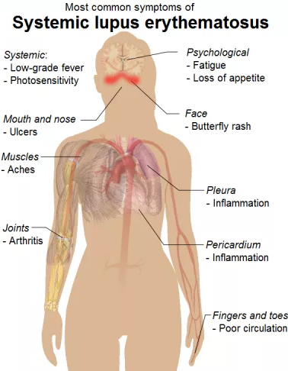
Systemic lupus erythematosus (SLE)
SLE or lupus is a autoimmune disease in which the body’s immune system attacking healthy tissues
Lupus causes inflammation in multiple organs and a wide variety of symptoms
Global prevalence from 20 to 70 per 100,000
It occurs 9 times more often in women than in men
There is no cure
Genetics play a role in susceptibility
Mouse model: male BXSB develops spontaneous lupus-like autoimmune syndrome

Slide 3
Introduction of BXSB mouse strain
breakpoint
Chromosome Y (C3H)
YAA (B6)
PAR (B6)
Chromosome X (B6)
YAA (B6)
PAR (B6)
BXSB is an inbred strain by intercrossing progenies of B6 females to SB male
BXSB autosomes are mosaic of B6 and SB, BXSB sex chromosomes are illustrated as above
Yaa mutation in SB: translocation from telomeric end of the X onto the Y chromosome
Yaa locus and BXSB genomic background both relevant to SLE development
Genetic mechanisms are not clear

Slide 4
Yaa context: 10 Mbp telomeric end of X chromosome
PAR
PAR: pseudo-autosome region of chromosome X and Y pair and recombine during meiosis (0.96 and 0.90 Mbp)

Slide 5
Yaa context: 10 Mbp telomeric end of Y chromosome
PAR

Slide 6
Experiment design
Gene expression measurement on B/T cells from multiple genetic backgrounds
YAA: backcrossing BXSB male with B6 females
YAA-IL21R: backcrossing BXSB male with B6 female (IL21R-/-)
Gene expression measured by microarray

Slide 7
Batch factors: sample prep date

Slide 8
Il21r
Il21r: protein coding, interleukin 21 receptor, chromosome 7

Slide 9
Nfkb1
Nfkb1: protein coding, nuclear factor of kappa light polypeptide gene enhancer in B cells, chromosome 3
20120530 batch suspicious, took off

Slide 10
Tlr7
Tlr7: protein coding, toll-like receptor 7, chromosome X
Yaa-TLR(-/+) level not low, took off all Tlr7

Slide 11
Samples

Slide 12
Cell type (B/T) signal dominates the data

Slide 13
How much effect batch factor carry?
PCA on T cell samples only (14 samples), batch correlate with major PCA signal

Slide 14
How much effect batch factor carry?

Slide 15
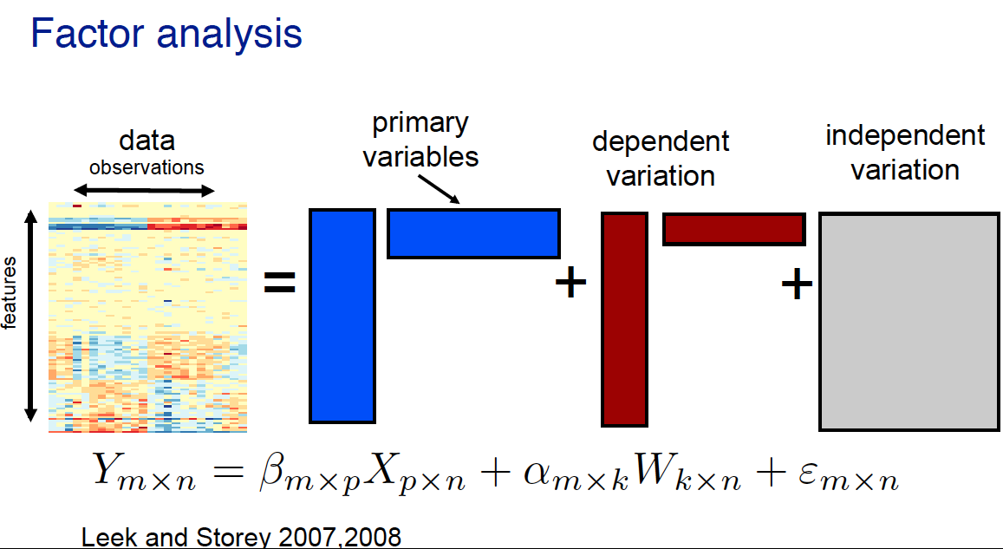
Batch correction by factor analysis

Slide 16
Model
Y ~ cell + genoYaa + genoIL21R + genoNfkb1 + cell * genoYaa + cell * genoIL21R + cell * genoNfkb1
cell: B, T
genoYaa: B6, Yaa
genoIL21R: WT, IL21R
genoNfkb1: WT, Nfkb1

Slide 17
Batch correction by factor analysis

Slide 18
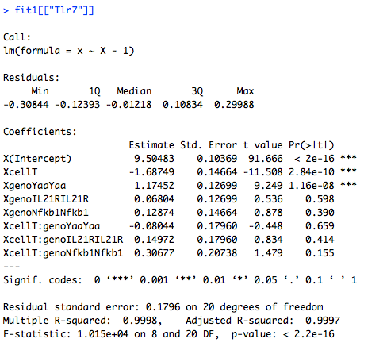
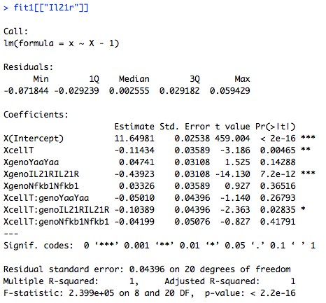
Model fit

Slide 19
Model

Slide 20
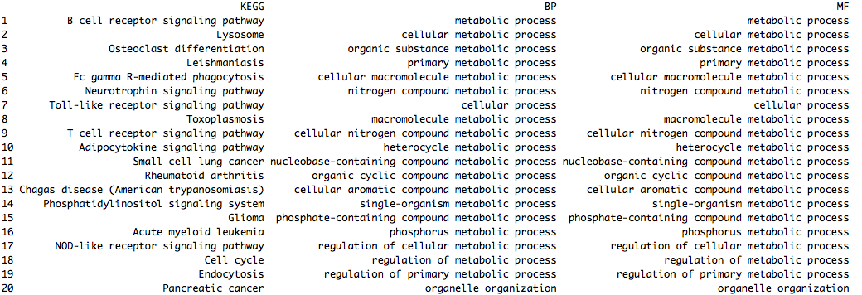
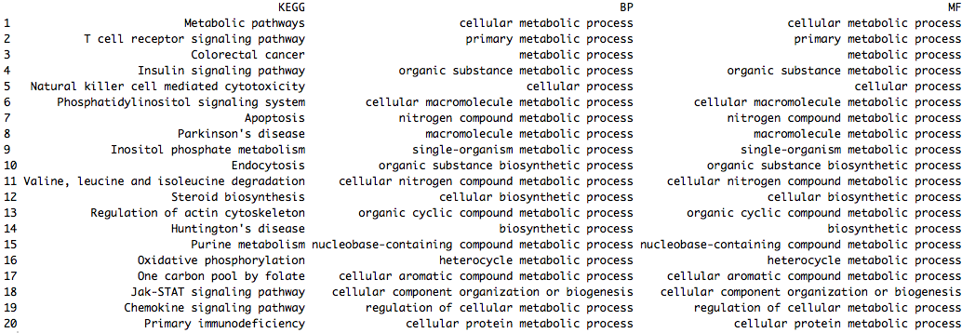
B and T cell genes in B6

Slide 21
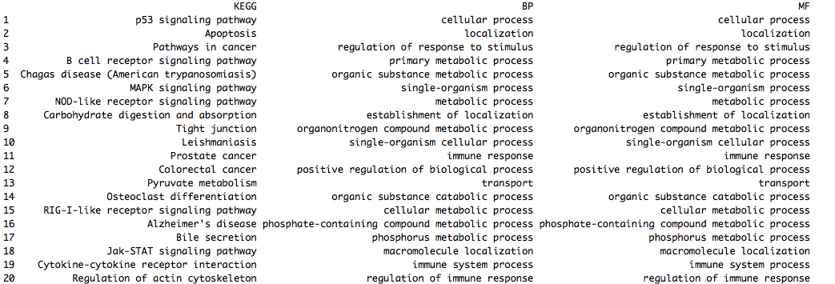
T-cell specific Nfkb1(+/-) effect, conditional on Yaa strain

Slide 22
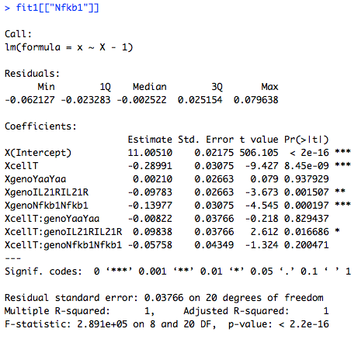
Model fit

Slide 23
RNA sequencing on BXSB and BXSB^{B6Y}
BXSB.B6Y by breeding BXSB female with B6 male, so BXSB Y was replaced by B6 Y
Samples: Splenic cells from 10 week old BXSB and BXSB.B6Y (3 and 4, all males)
Pipeline: fastq were trimmed with Trimmomatic, reads were aligned to BXSB pseudo-transcriptome with Bowtie, gene expression levels were estimated with RSEM
Aligning to BXSB pseudo-genome increases alignment rate by approximately 1%
Is the 1% difference in alignment rates causing different estimations on gene expression?

Slide 24
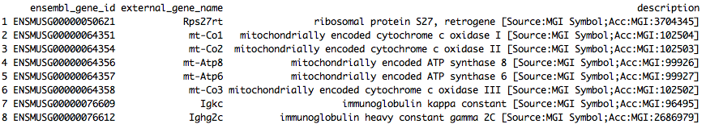
Outlier genes
Igkc and Ighg2c are both annotated for Immunoglobulin (Ig) and T-cell receptor (TcR) Igkc high and twice more in BXSB. Ighg2c higher in BXSB.B6Y. What are they doing?

Slide 25
Outlier genes
I took off the outlier genes and re-normalize the TPM for downstream analysis.

Slide 26
Transcriptional processes in BXSB and BXSB.B6Y splenic cells are very different
q-value < 0.05, log2 fold change > 0.3
1724 out of 9678 are differential
Why the signal so strong?

Slide 27
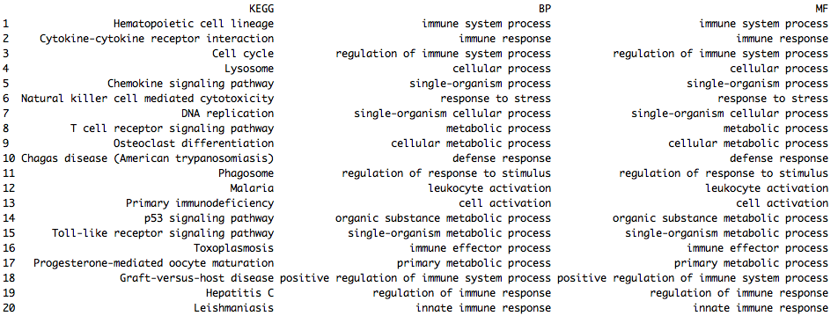
Differential genes are also immunological genes

Slide 28
Materials and Methods
Exome sequencing
BXSB
RNA sequencing
BXSB, BXSB^{B6Y}
Microarray
B6, B6^{YAA}
FASTQ trim
FASTQ trim
Normalization (RMA)
Alignment: Bowtie
Alignment: Bowtie
B6 and BXSB pseudo-genome
DE genes
Variant call
samtools, GATK, VarScan
Expression estimation: RSEM
BXSB pseudo-genome
DE, pathway, Immgen
Microarray: CD3CD4 T-cells
RNA sequencing: Splenic cells from 10 week old BXSB and BXSB.B6Y
BXSB.B6Y males carry the B6 Y chromosome in place of the mutant Yaa-containing Y chromosome of BXSB inbred male mice.

Slide 29
Transcriptional differences between B6 and B6.YAA
p-value < 0.05
977 out of 21755 are differential

Slide 30
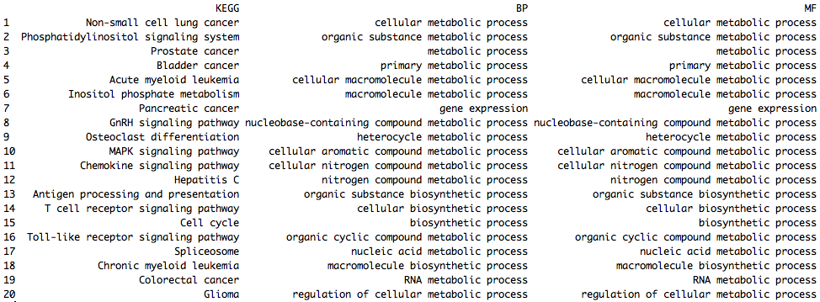
Differential genes are metabolic

Slide 31
Interaction between YAA and genomic backgrounds
DE1: Yaa-targeting genes in the B6 background
B6
Yaa-
B6
Yaa+
DE2: Yaa-targeting genes in the BXSB background
BXSB
Yaa-
BXSB
Yaa+
Intersection between DE1 and DE2 are Yaa-genes irrelevant of genomic background
DE2-specific genes reflect interaction between Yaa locus and BXSB genomic background
DE1-specific genes reflect interaction between Yaa locus and B6 genomic background

Slide 32
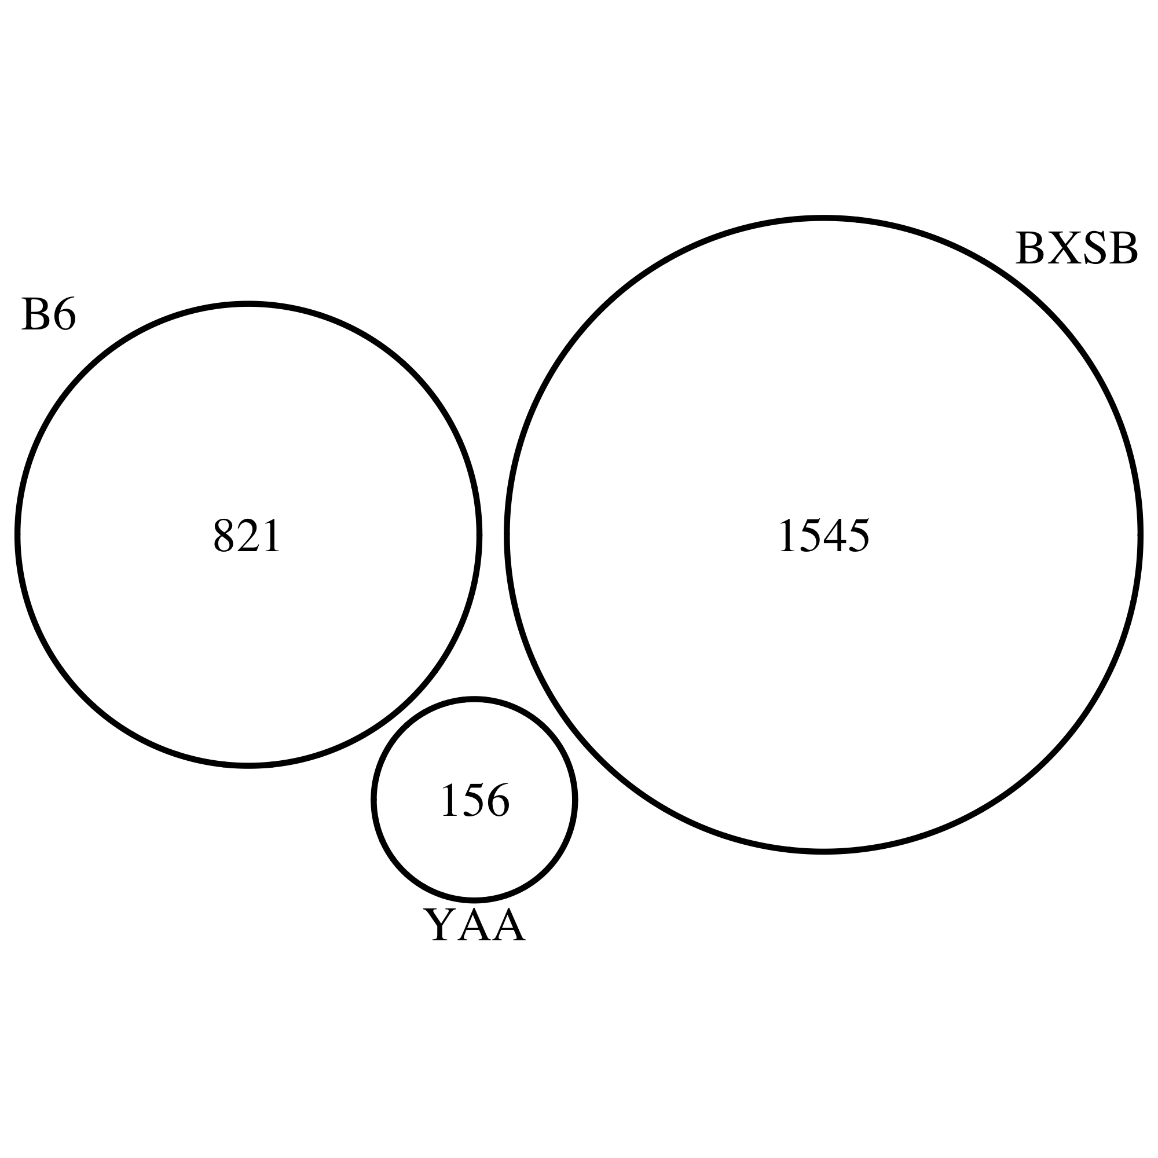
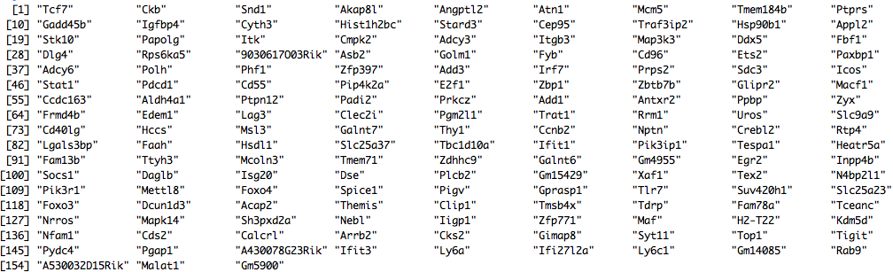
Strong BXSB-specific signal

Slide 33
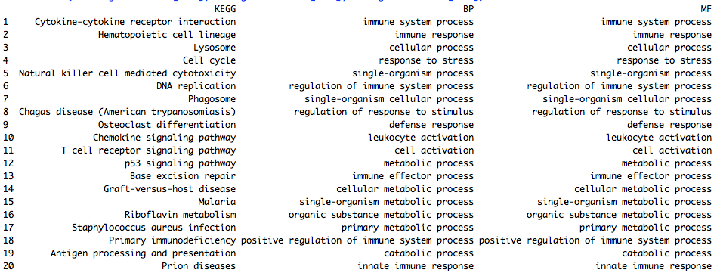
BXSB-specific genes are immunological

Slide 34
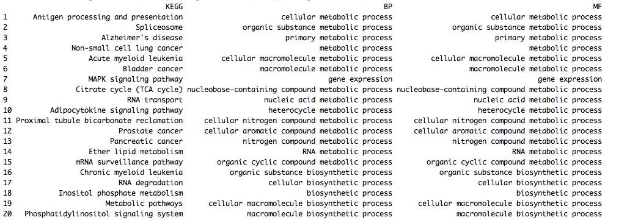
B6-specific genes are metabolic

Slide 35
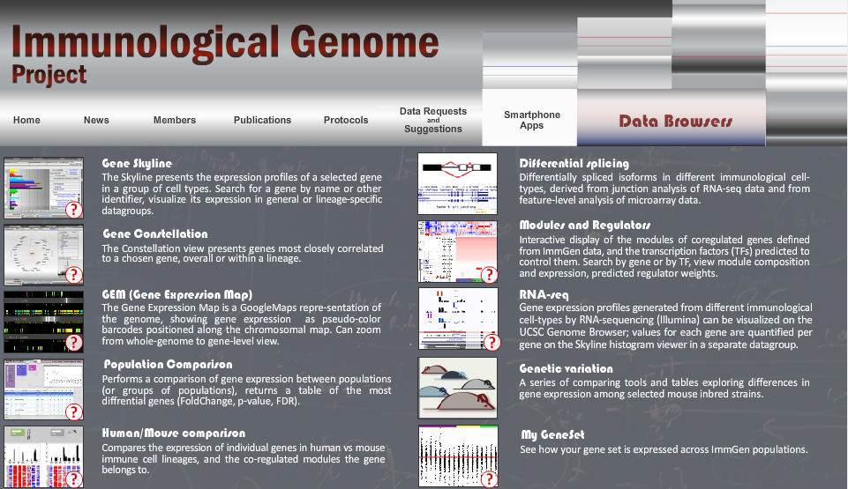
ImmGen modules

Slide 36
BXSB-specific genes in Immgen modules
Top regulators of module 24: Klf9, Tcfec, Ctbp2, Creg1, Tcfe3
Top regulators of module 25: Cebpb, Irf5, Ciita, Atf6

Slide 37
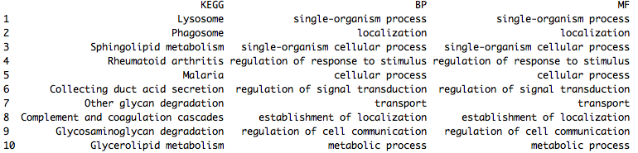
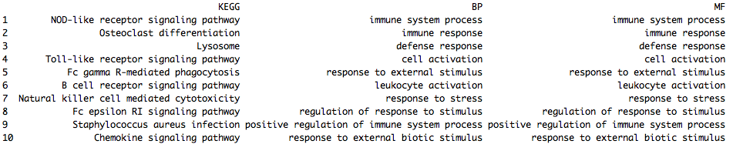
Module 25 is interesting
Module 24
Module 25

Slide 38
Genomic differences of B6 and BXSB

Slide 39
Predict variant’s effect

Slide 40
Discussion
Biology of ImmGen modules
Map BXSB-specific signal to cell subtypes (ImmGen) and IL21 signaling
BXSB variants-affecting genes

Slide 41
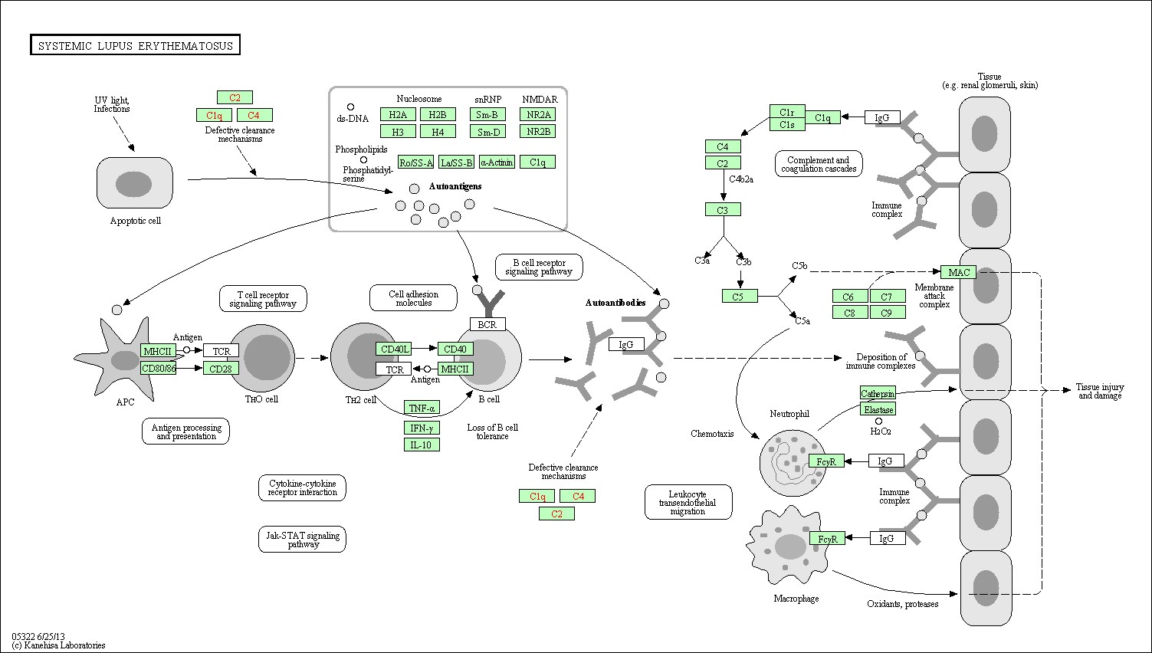
KEGG: SLE

Slide 42
Facts, questions, and approaches
What we know?
YAA mutation was identified to be a translocation from the telomeric end of the X chromosome onto the Y chromosome
YAA locus contains Tlr7 gene, but the exact genomic range is unclear
The accelerated development of SLE in male BXSB mice is associated with the genetically abnormal YAA locus in its Y chromosome
BXSB mice with a B6 Y chromosome do not develop the disease
C57BL/6J mice carrying the YAA gene are indistinguishable from wild type controls
What we have?
B6 and BXSB genome (Steve Munger)
RNA-seq on wild type BXSB and BXSB with B6 Y chromosome
Microarray on wild type B6, and B6 with BXSB Y chromosome
Differential genes, GO, KEGG, and master regulators
What are the questions and how to approach?
What are the genomic differences between BXSB and B6 that are functional?
How to refine the YAA locus?
How to infer a model from the differential genes between BXSB and BXSB^{B6(Y)} in terms of protein cascade?
How the BXSB background cooperate with the extra YAA locus on Y chromosome to accelerate SLE development?
Identify the differential genes between BXSB WT and B6 with BXSB Y chromosome
Integrate the IL21 data or not? How?

Slide 43
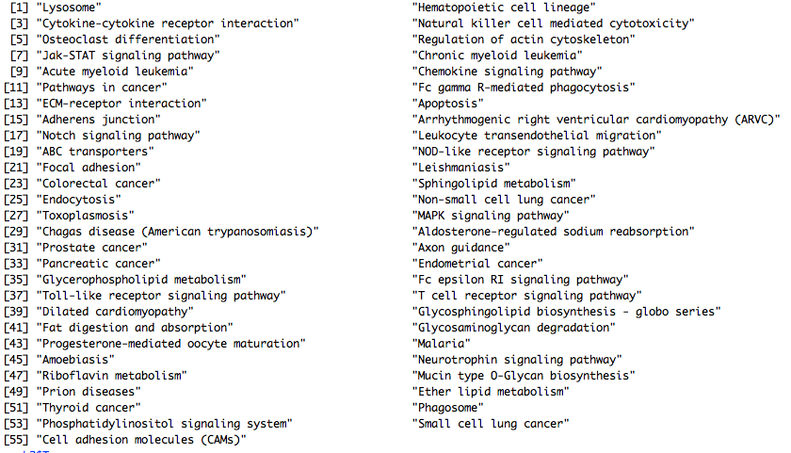
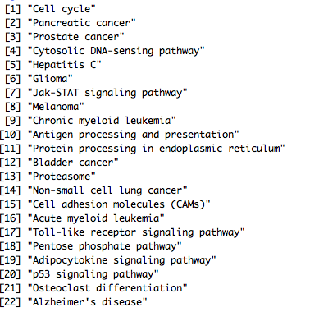
BXSB is the only SLE-causing

Slide 44
IL21 signaling?
 | IL21^{N}ICOS^{N} | IL21^{N}ICOS^{P} | IL21^{P}ICOS^{P}
BXSB^{B6} | 190*** | 100 | 68
BXSB^{YAA} | 43 | 193 | 217***
Fisher’s test: p value equals 2.2e-16
Chi-square test: p values equal 6.613e-12 and 1.52e-13 for BXSB^{B6} and BXSB^{YAA}

Slide 45
TO DO
WES variants detection
WES CNV detection
Personalized exome and its effect gene expression estimation
B6 array data
RNA-seq

Slide 46
Figure 1. Genetic variations of BXSB
BXSB and BXSB_b6y (total spleen)
Cell types
Tlr7 to
Metabolic process
microRNA (cs)
SB strain mutations
Yaa locus boundary

